Slide 1

COFFEE PRICE ANALYSIS
BY,
DEEPAK.B

Slide 2
Overview:
Problem Statement
Methodology
Key findings
Helpful for business
Conclusion

Slide 3
PROBLEM STATEMENT
This paper presents coffee price analysis system by using the supervised machine learning technique. The research uses Regression as the machine learning prediction method.
Using linear regression ,Decision Tree Regressor ,Random Forest Regressor there are multiple independent variables but one and only one dependent variable whose actual and predicted values are compared to find precision of results.
Keywords----Linear regression, Coffee Price, Regression model, Machine Learning

Slide 4
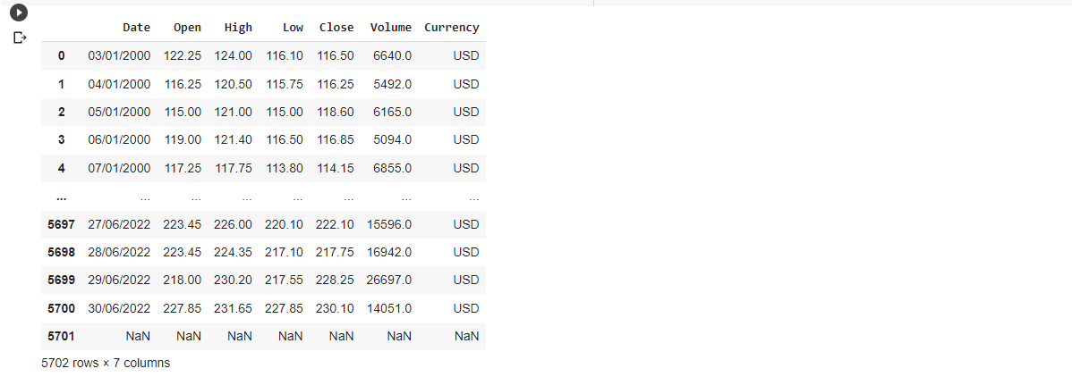
METHODOLOGY
STEP 1:ANALYZING DATASET

Slide 5
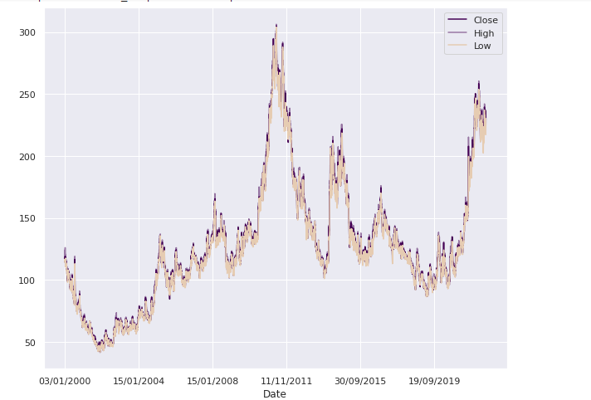
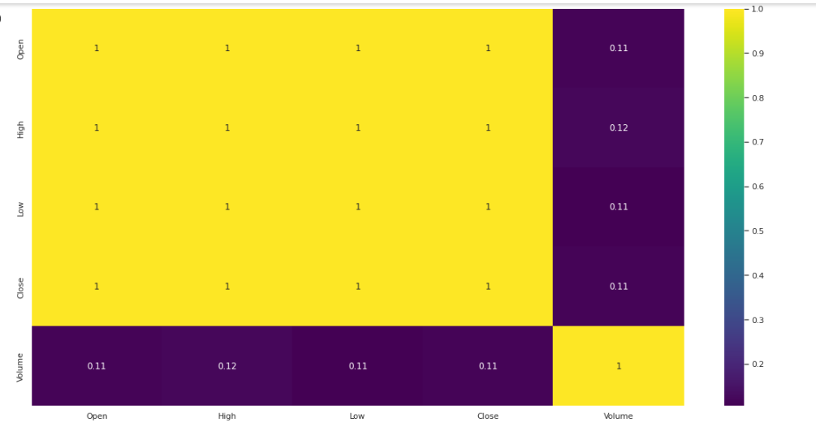
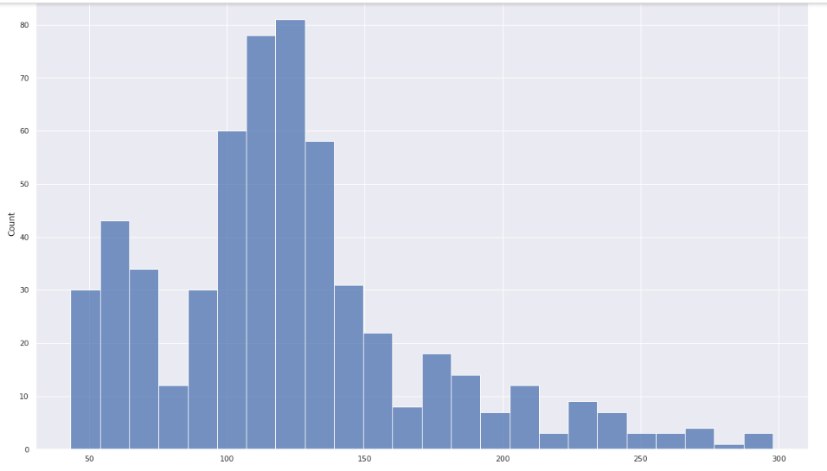
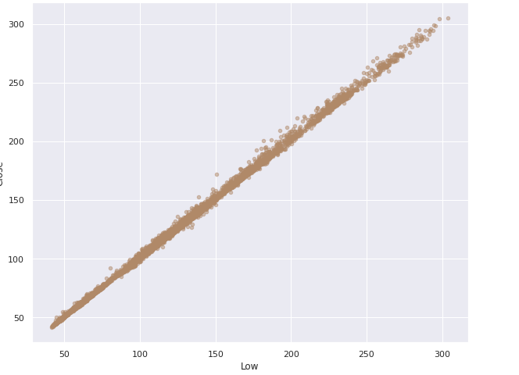
STEP 2:DATA VISUALIZATION

Slide 6
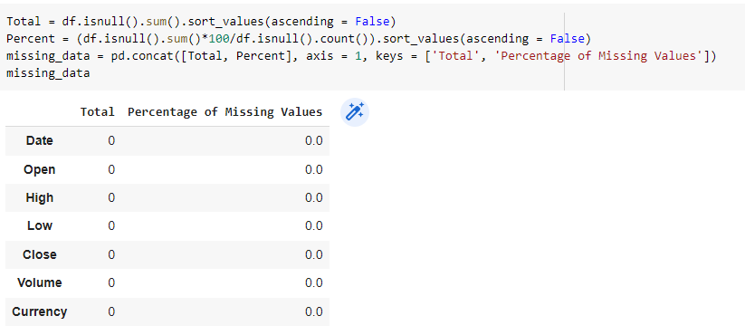
STEP 3:CHECKING NULL VALUES AND MISSING VALUES:
In our dataset we are checking for missing values and null values.
Next we are checking for duplicated values.

Slide 7
STEP 4:Training the dataset and finding the Accuracy
Taking the “X” value as ‘Low’.
Taking the “Y” value as ‘Close’ which gives the accuracy.
Train both the X and Y value and analyse the dataset.
Plot the values of the given dataset using the functions of matplot and seaborn.
After using EDA and trained dataset then find the accuracy of the given model.

Slide 8
KEY FINDINGS
In this project I used 3 Algorithms:
Linear Regression
Decision Tree Regressor
Random forest Regressor
All these are executed and Linear Regression
gives the higher accuracy of 99.85%.

Slide 9
HELPFUL FOR BUSINESS
Most of the peoples in our country do no the price of the Coffee.
This project gives the historical analysis of coffee prices and realise the customer to summarize the coffee price.
If there is a scarcity of coffee, the price will go up until people decide not to buy because it is too high.
So we used the Regression model to find the less error to buy the coffee which is used in Business basis.

Slide 10
Conclusion:
Our model performed well on the testing data. With an accuracy of 99.85%, the results are promising that this model could be used in analysing the coffee prices.
We conclude the trend estimate is statistically insignificant, and the variability in the margin dominates any possible underlying trend in the margin.

Slide 11


